Slide 1

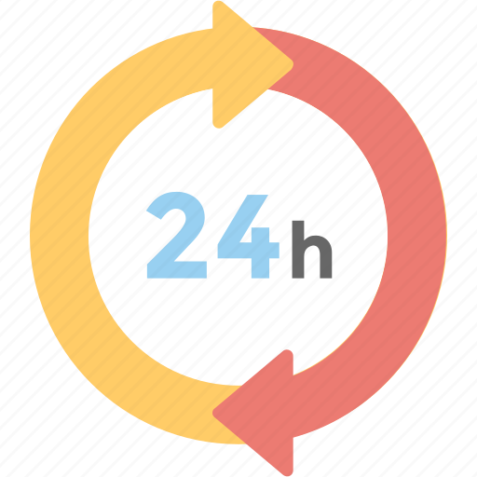
24-HOUR FORECAST
01-11-2022 @ 1200 UTC
Department of Meteorology and Climate Science,
KNUST

Slide 2
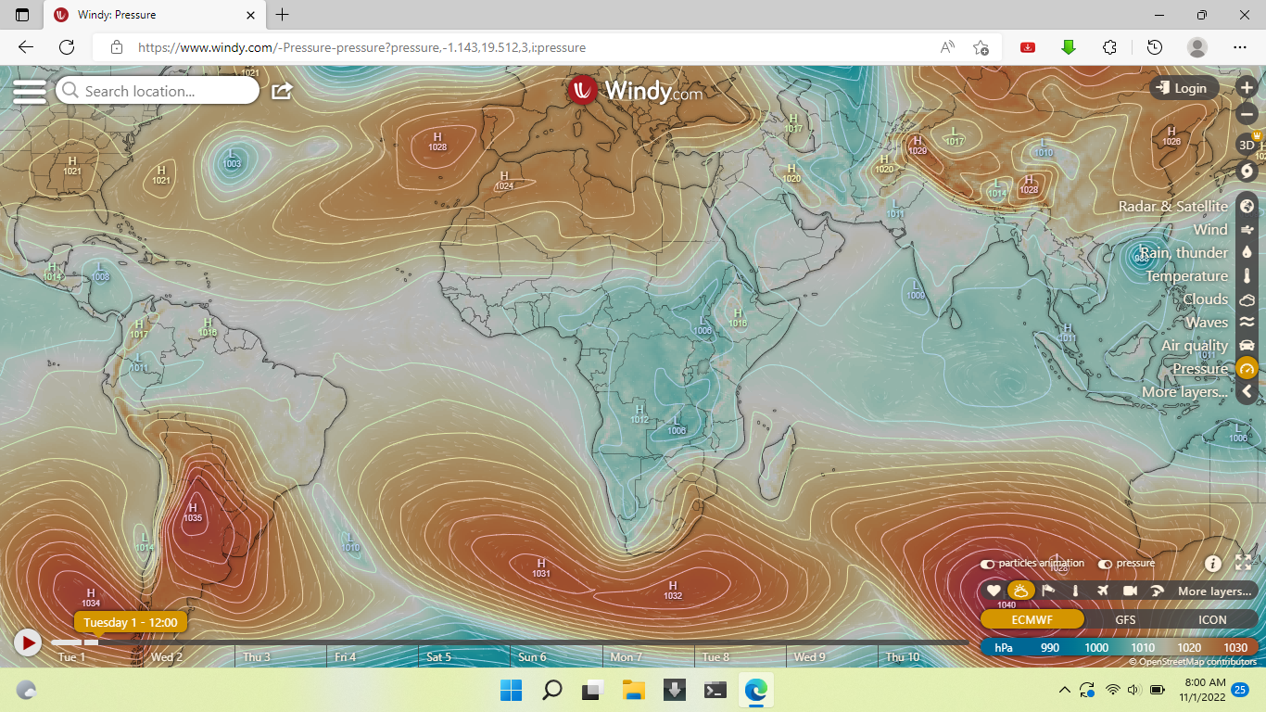

PRESURE SYSTEMS(hPa)
AT 1200 UTC
1028
1029
1031
$8^{O}$N
1032

Slide 3
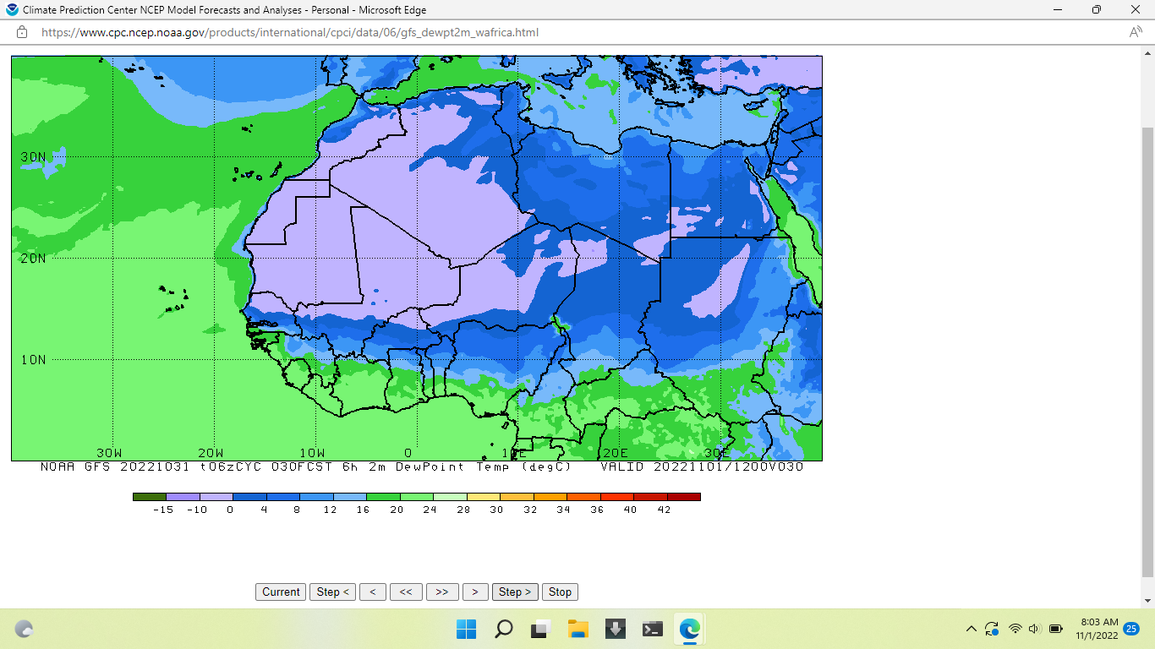

INTERTROPICAL DISCONTINUITY(ITD)
AT 1200 UTC
$8^{O}$N

Slide 4
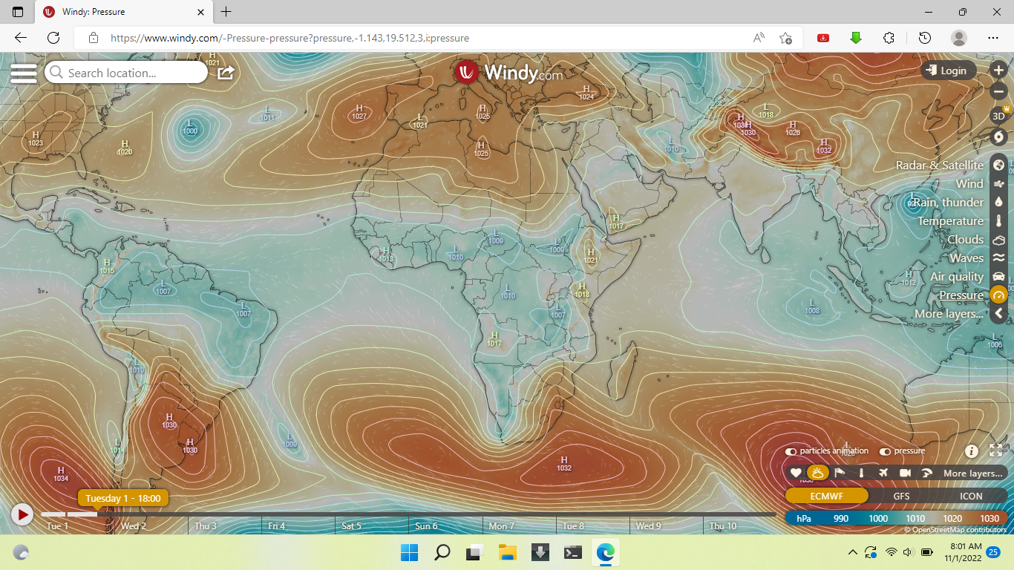
PRESURE SYSTEMS(hPa)
AT 1800 UTC
1027
1029
1032
1032

Slide 5
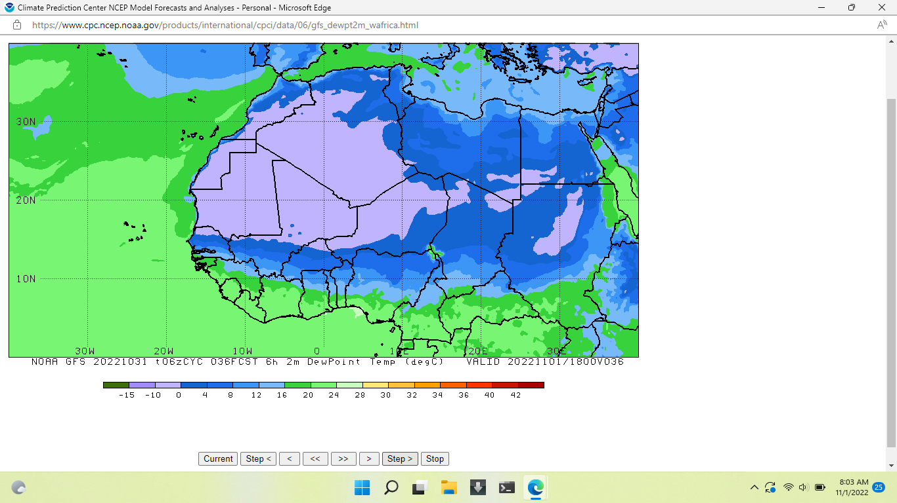

INTERTROPICAL DISCONTINUITY(ITD)
AT 1800 UTC
$6^{O}$N

Slide 6
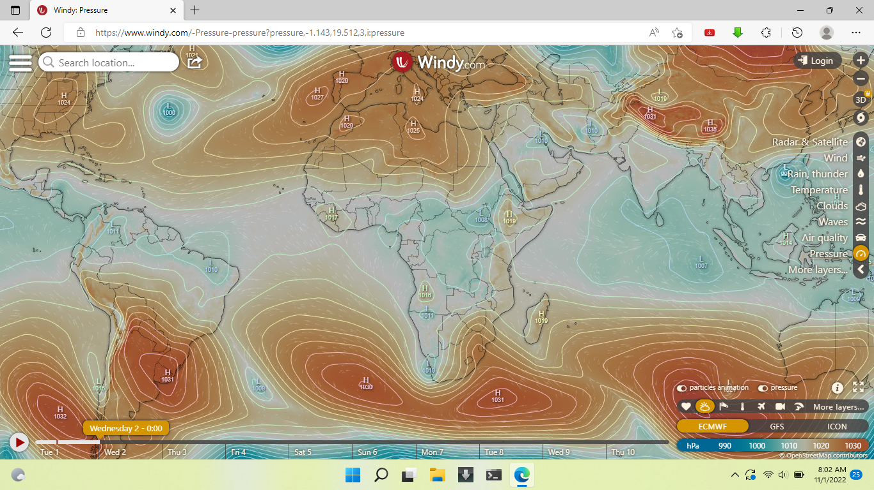
PRESURE SYSTEMS(hPa)
AT 0000 UTC
1027
1030
1032

Slide 7
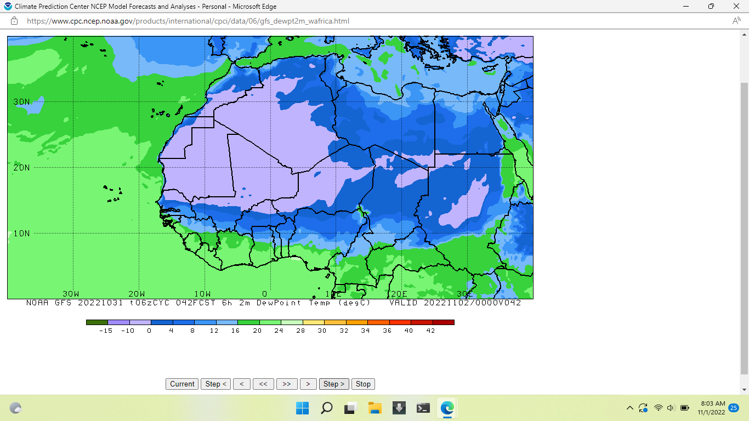

INTERTROPICAL DISCONTINUITY(ITD)
AT 0000 UTC
${7.6}^{O}$N

Slide 8
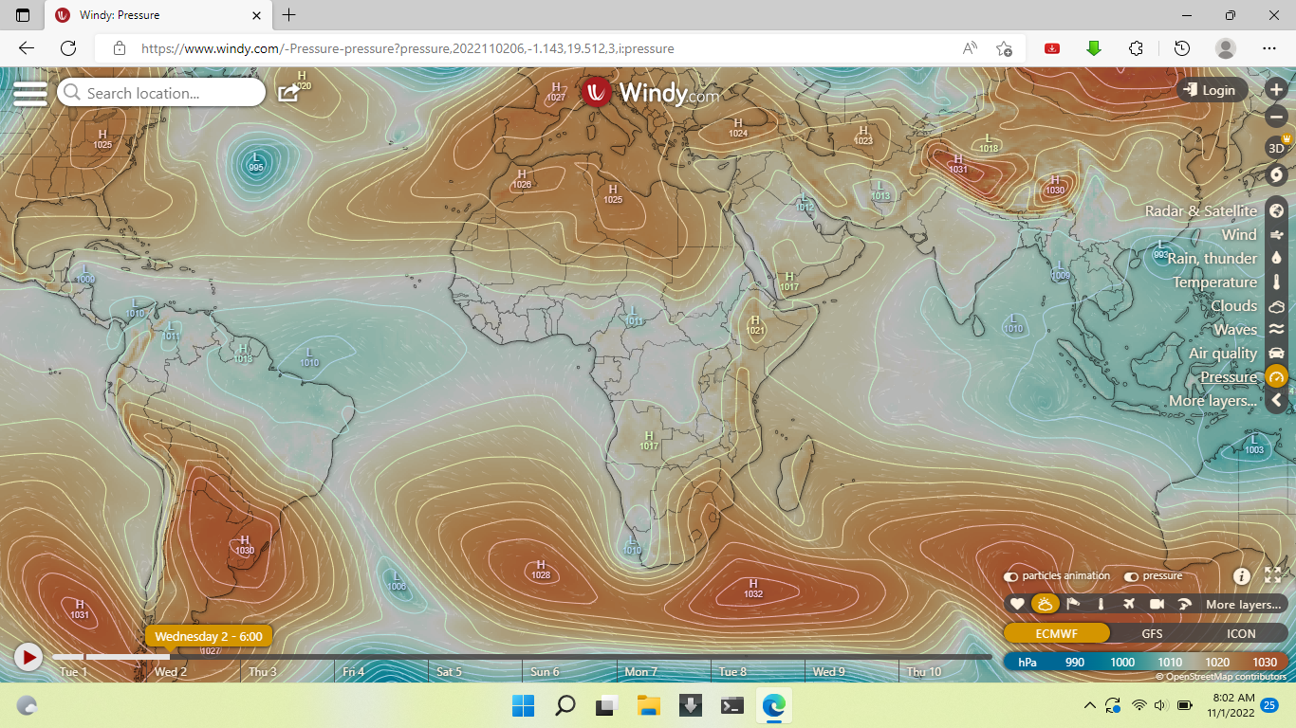
PRESURE SYSTEMS(hPa)
AT 0600 UTC
1026
1029
1028
1032

Slide 9
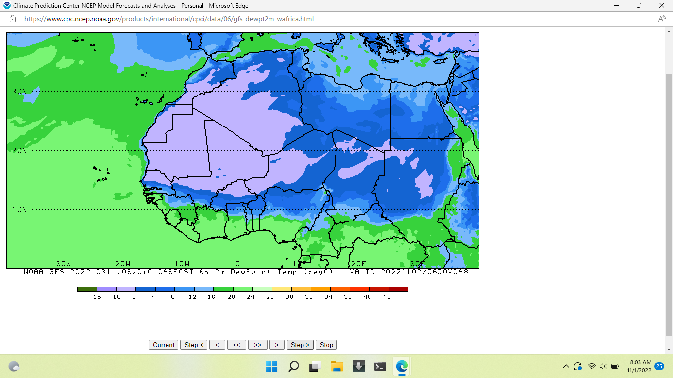

INTERTROPICAL DISCONTINUITY(ITD)
AT 0600 UTC
${7.7}^{O}$N

Slide 10
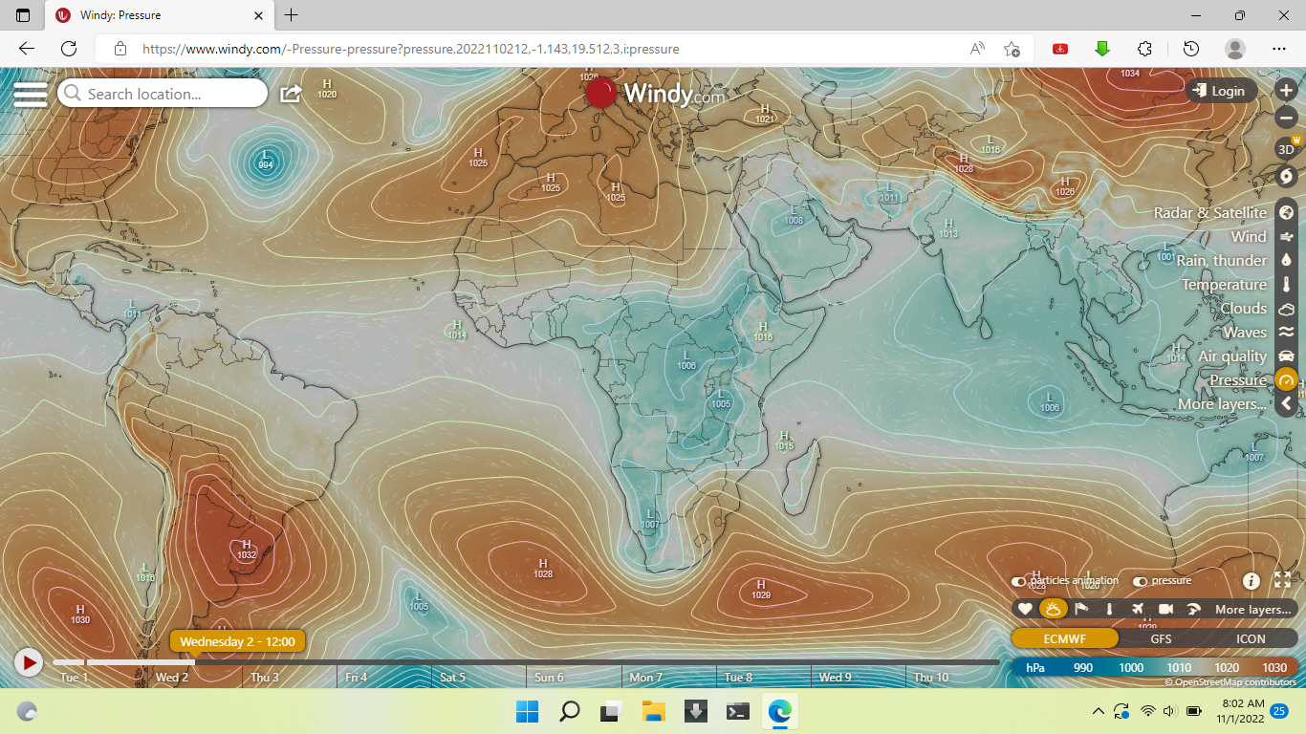
PRESURE SYSTEMS(hPa)
AT 1200 UTC
1025
1029
1028
1032

Slide 11
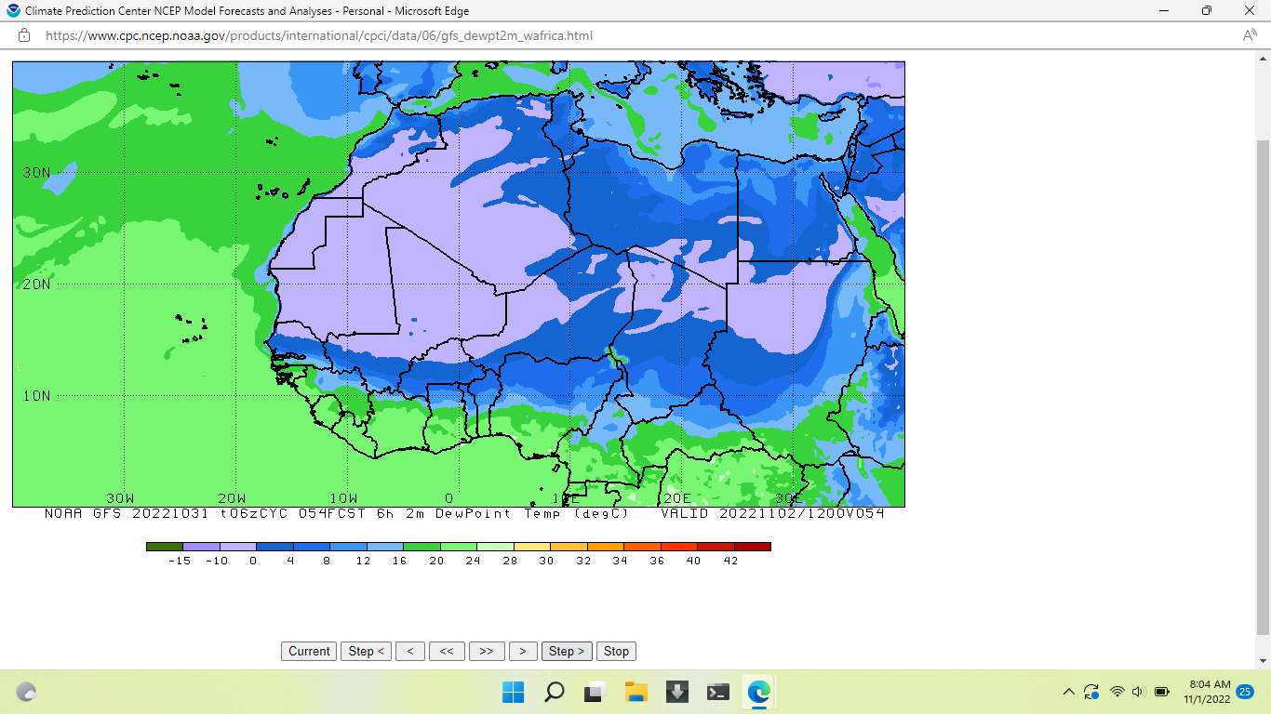

INTERTROPICAL DISCONTINUITY(ITD)
AT 1200 UTC
${7.9}^{O}$N

Slide 12
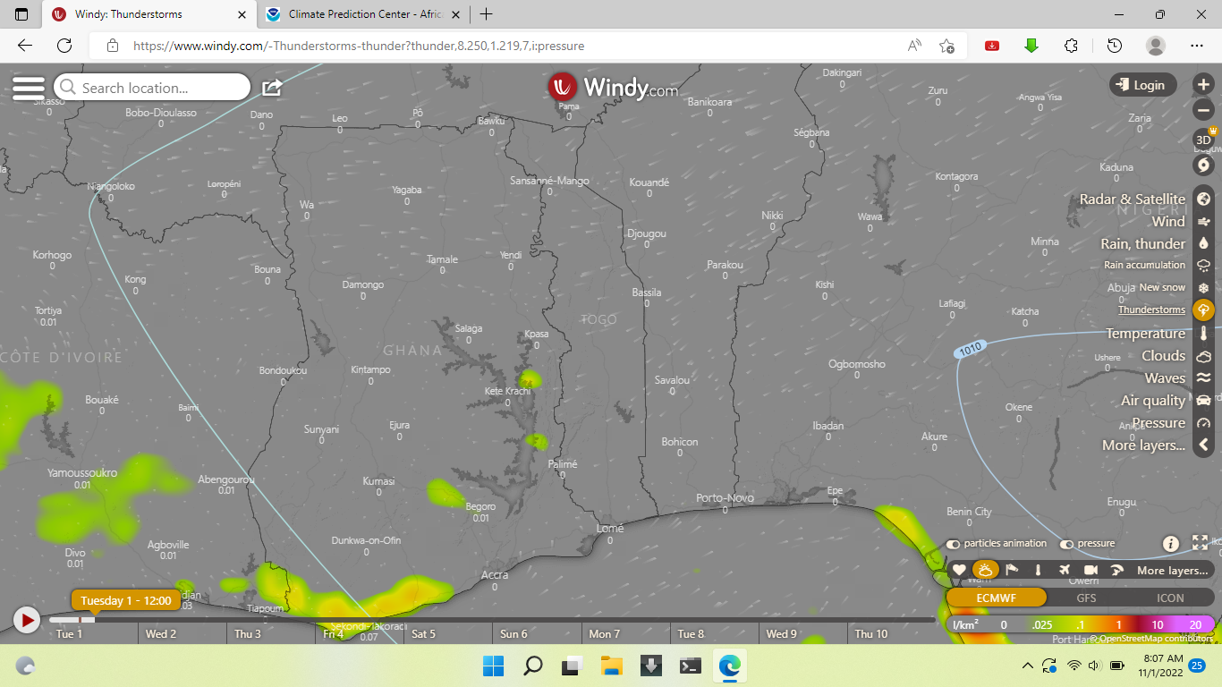
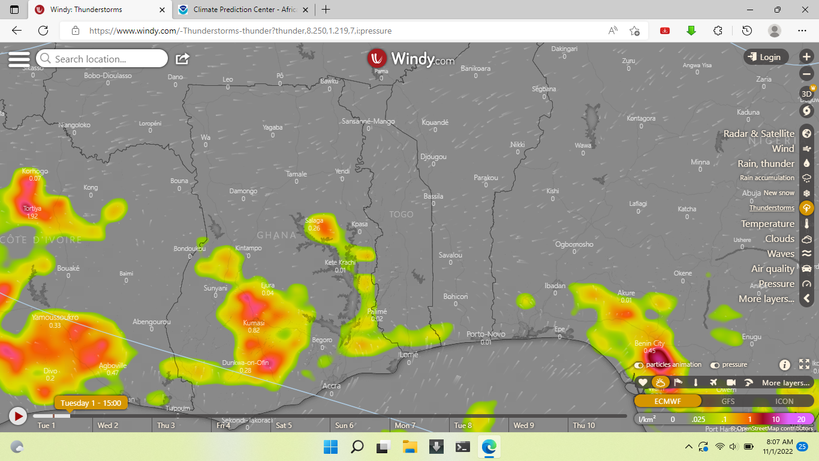
THUNDERSTORM PROJECTIONS
AT 1200 UTC
AT 1500 UTC

Slide 13
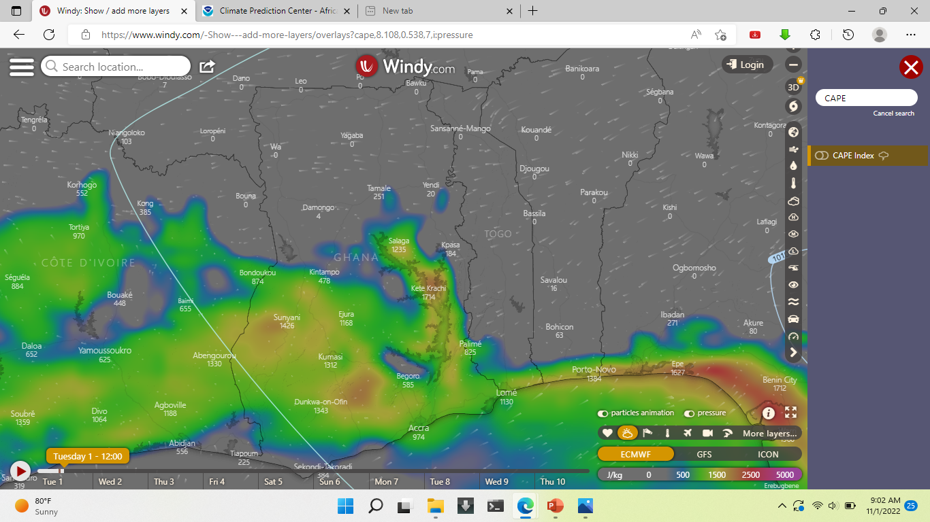
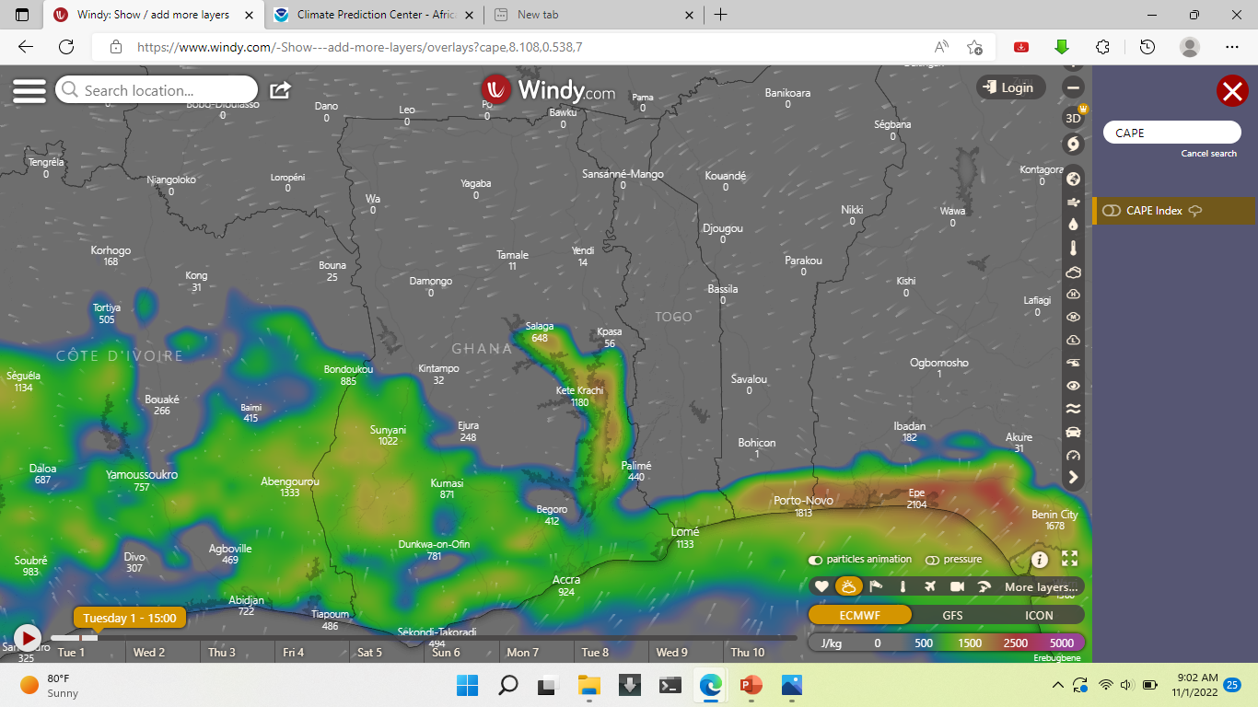
THUNDERSTORM PROJECTIONS
AT 1200 UTC
AT 1500 UTC

Slide 14
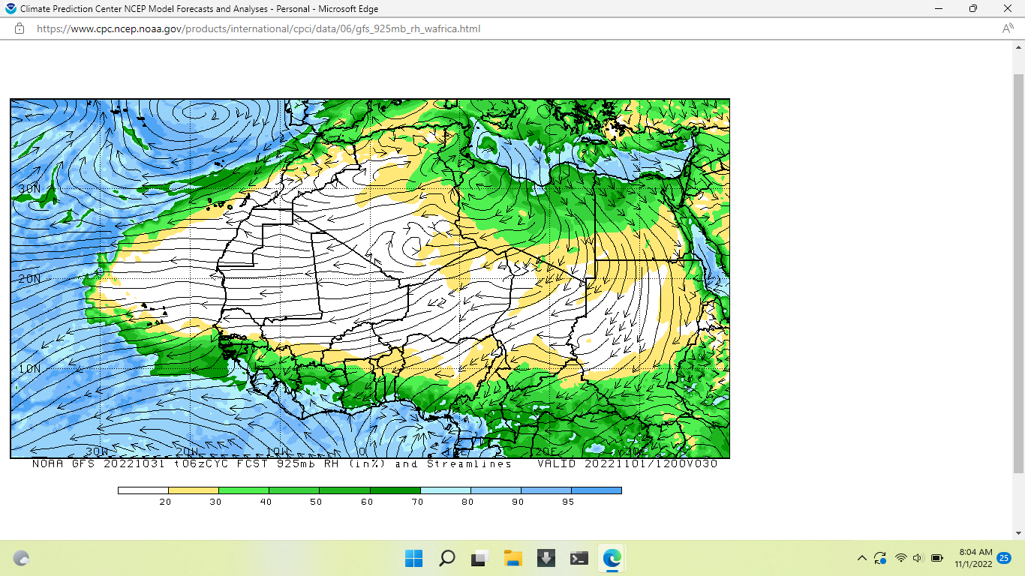
HUMIDITY@925hPa
AT 1200 UTC

Slide 15
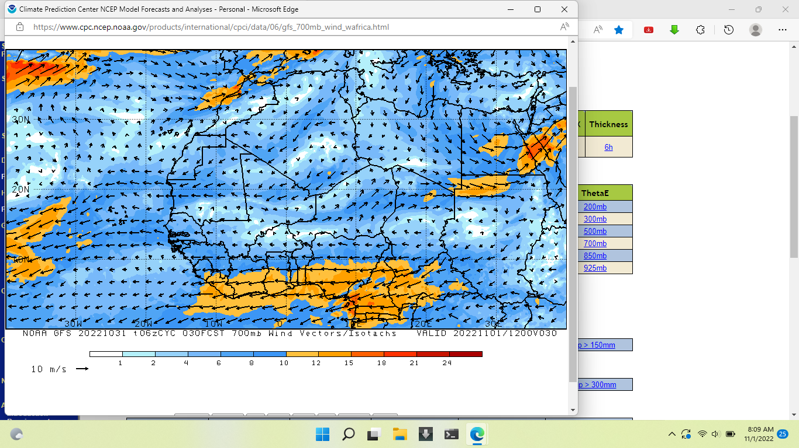
AFRICAN EASTERLY JET
AT 1200 UTC

Slide 16
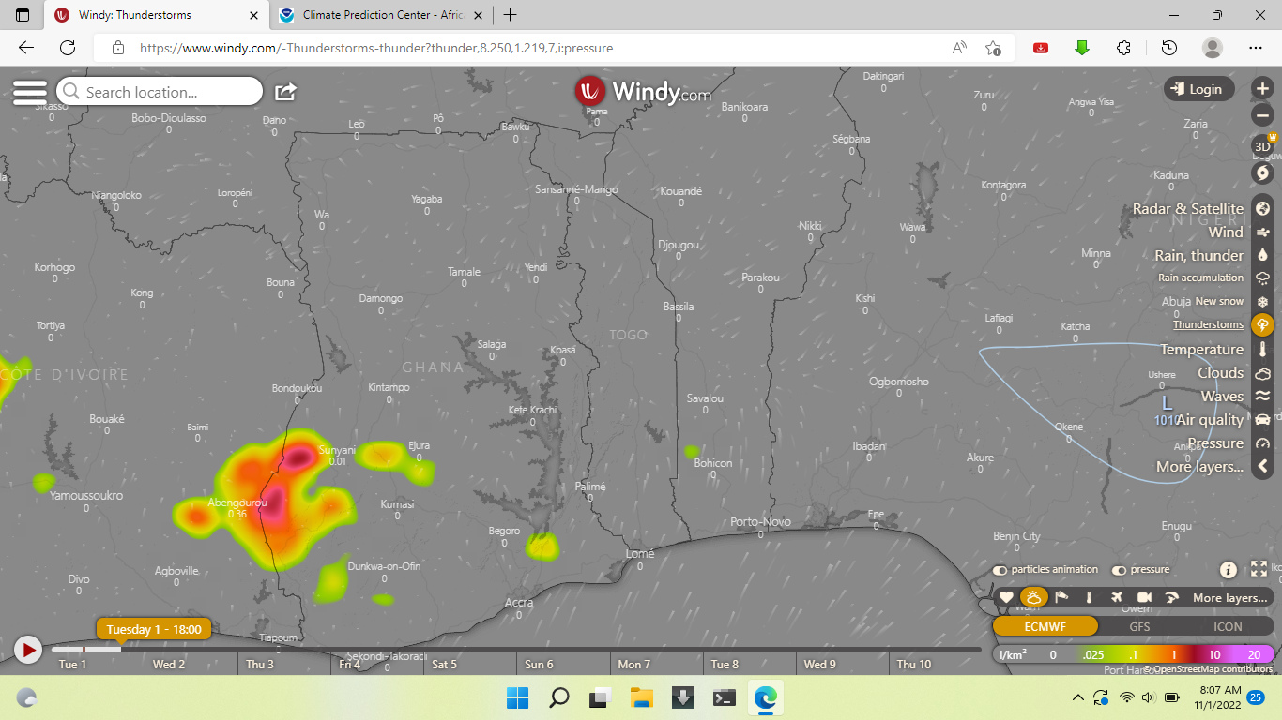
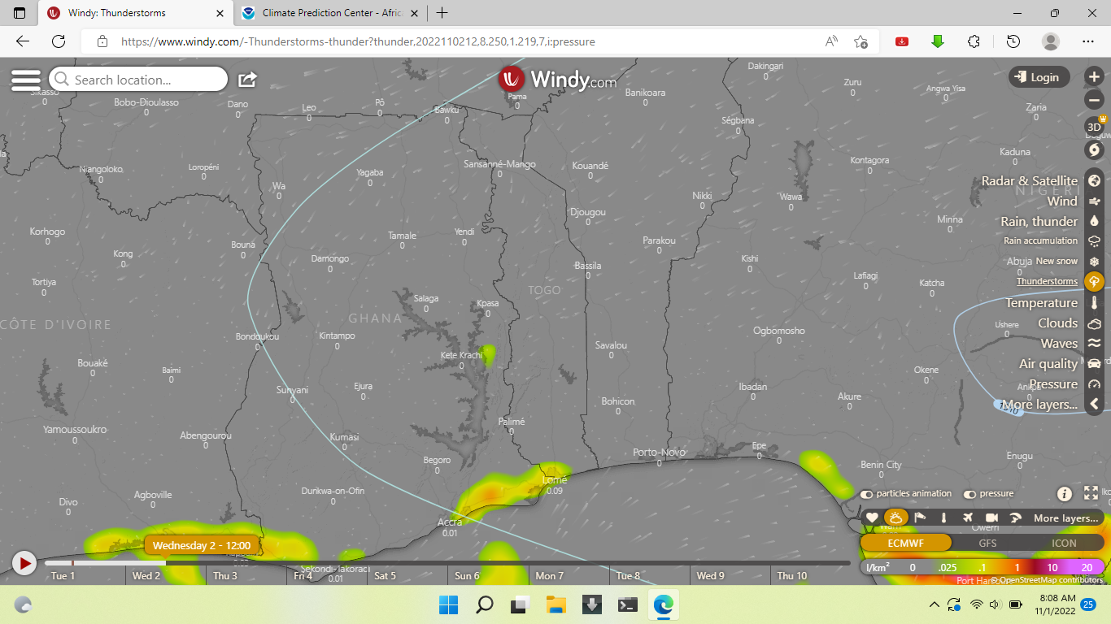
THUNDERSTORM PROJECTIONS
AT 1800 UTC
AT 1200 UTC

Slide 17
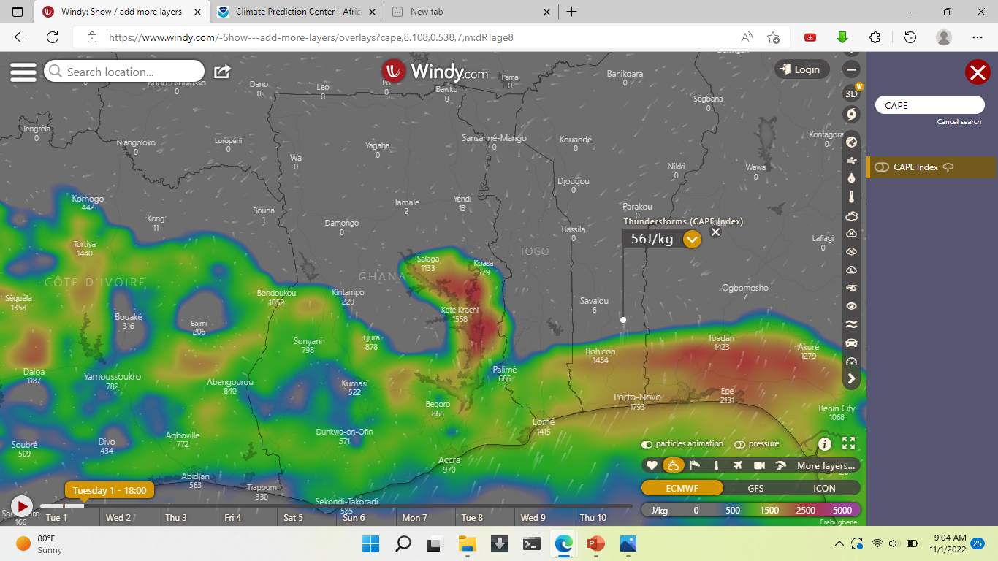
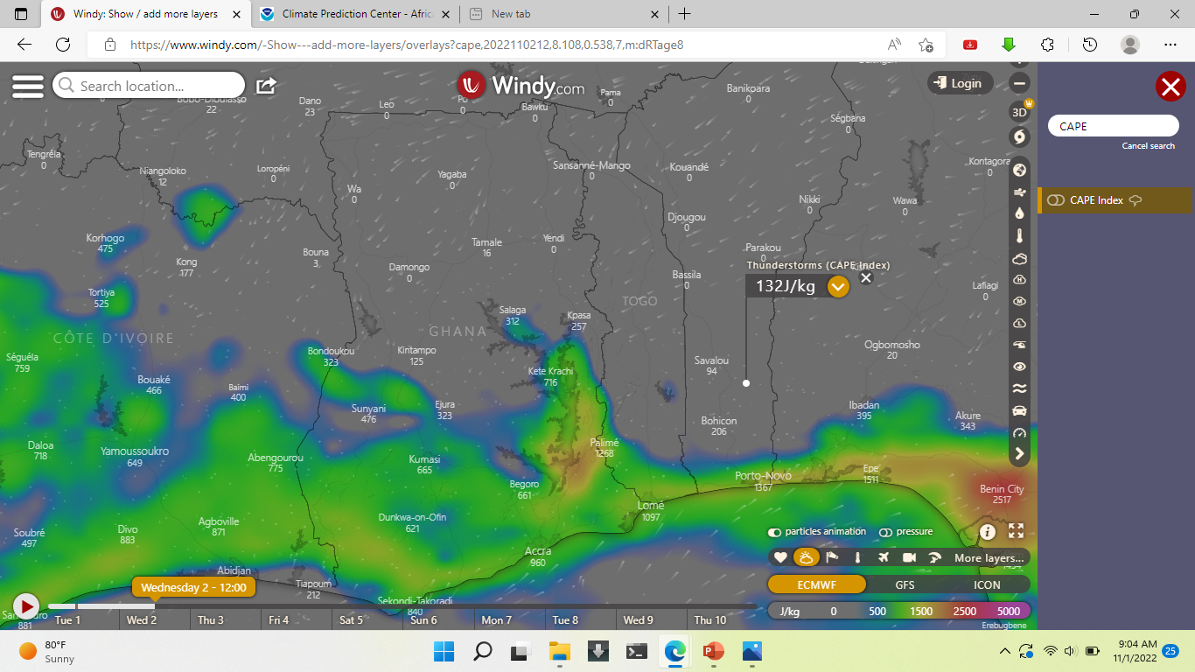
THUNDERSTORM PROJECTIONS
AT 1800 UTC
AT 1200 UTC

Slide 18
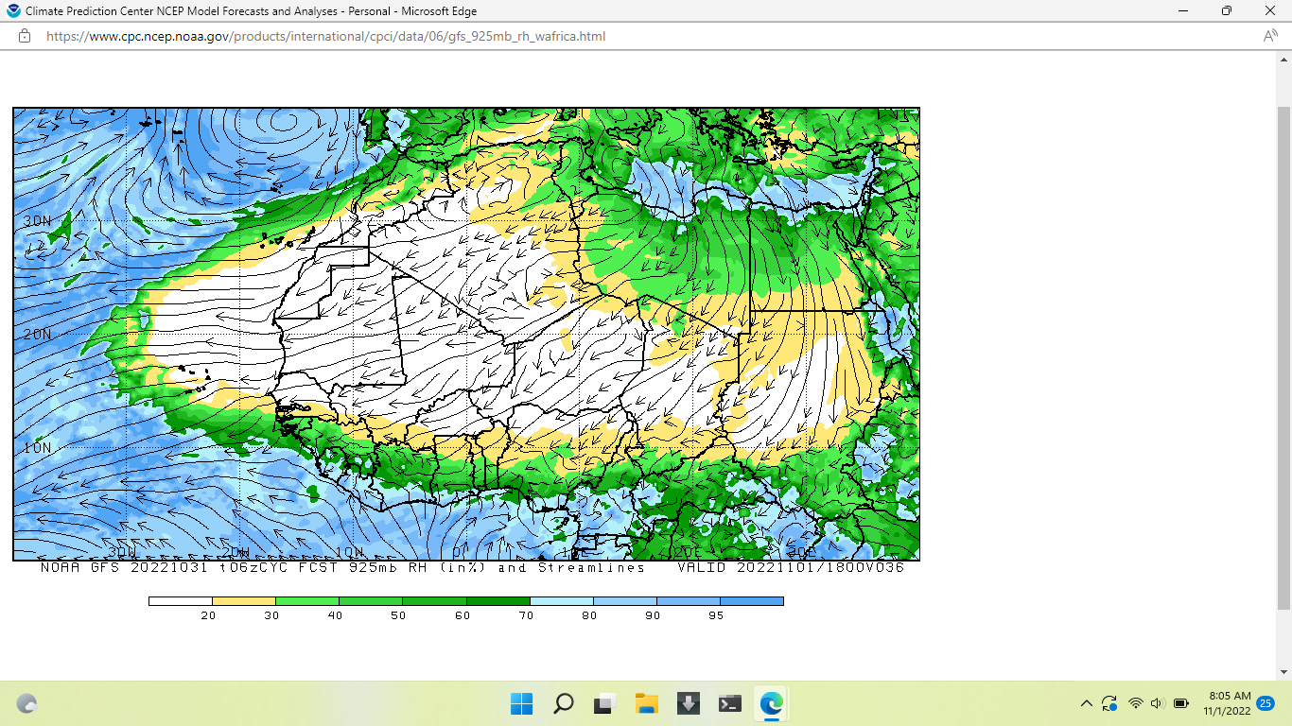
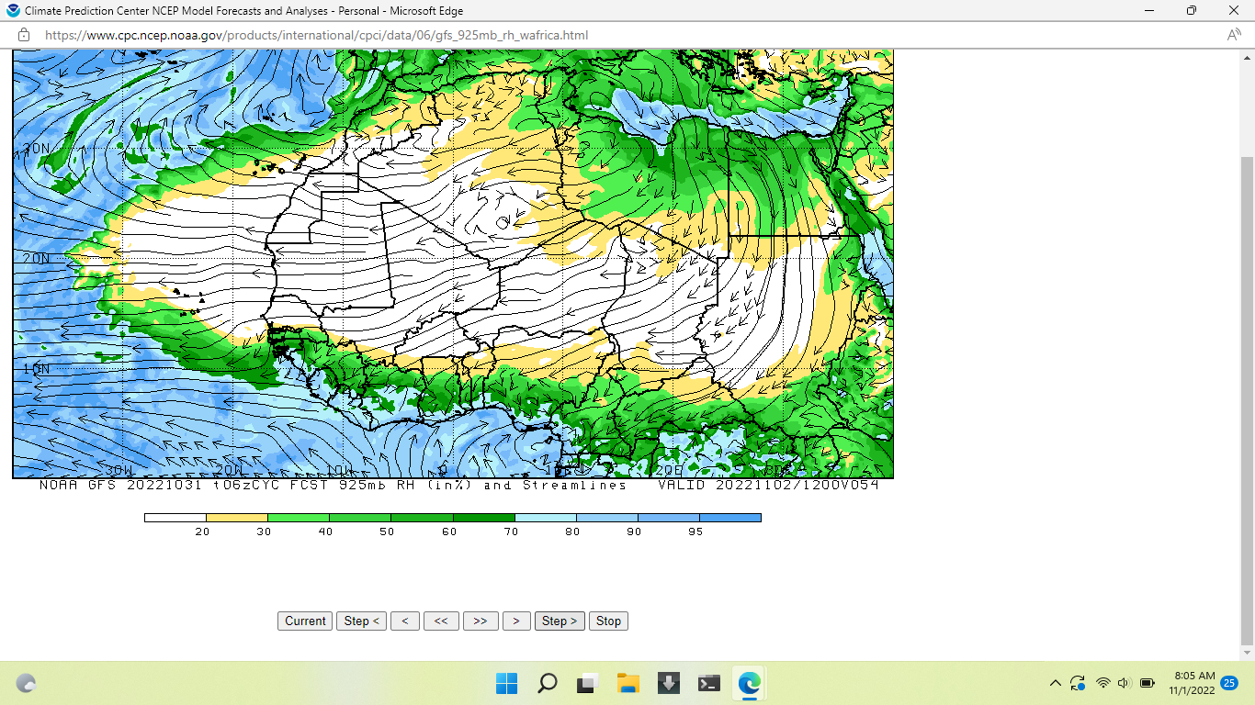
HUMIDITY@925hPa
AT 1800 UTC
AT 1200 UTC

Slide 19
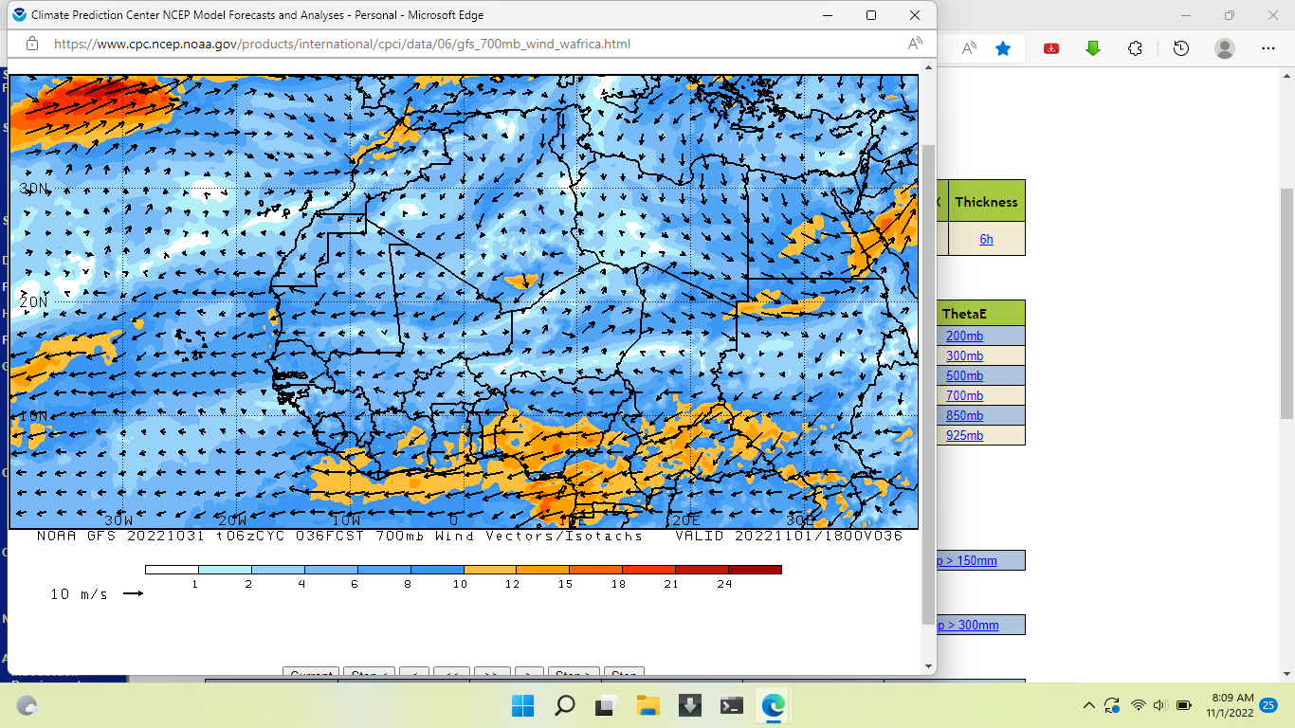
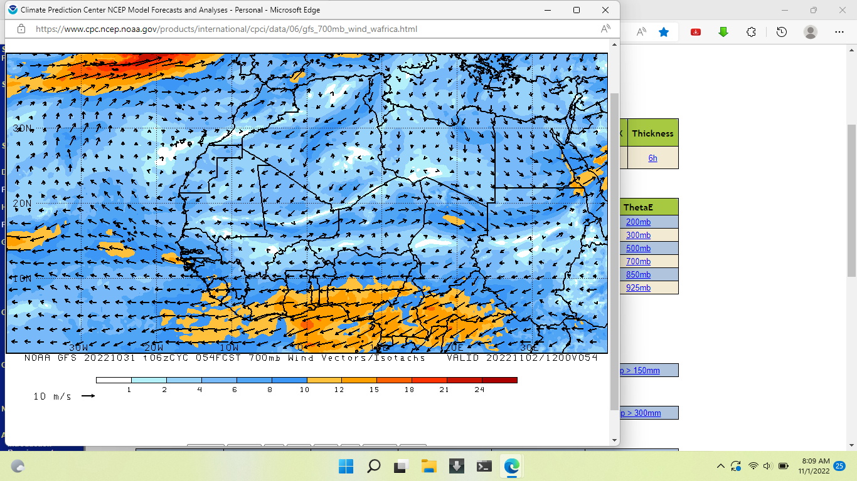
THUNDERSTORM PROJECTIONS
AT 1800 UTC
AT 1200 UTC

Slide 20
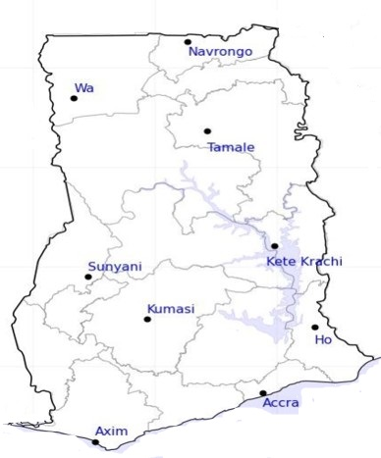

DAY
RH (%)
NIGHT
37
49
70
55
55
60
55
70
71
79
96
81
81
95
74
96
80
86
85
85

Slide 21


DAY
TEMP ($℃$)
NIGHT
35
27
34
27
34
27
34
27
31
28
29
23
25
30
23
24
28
27
27
26

Slide 22

PROBABILITY OF RAINS
(15-30)%

Slide 23

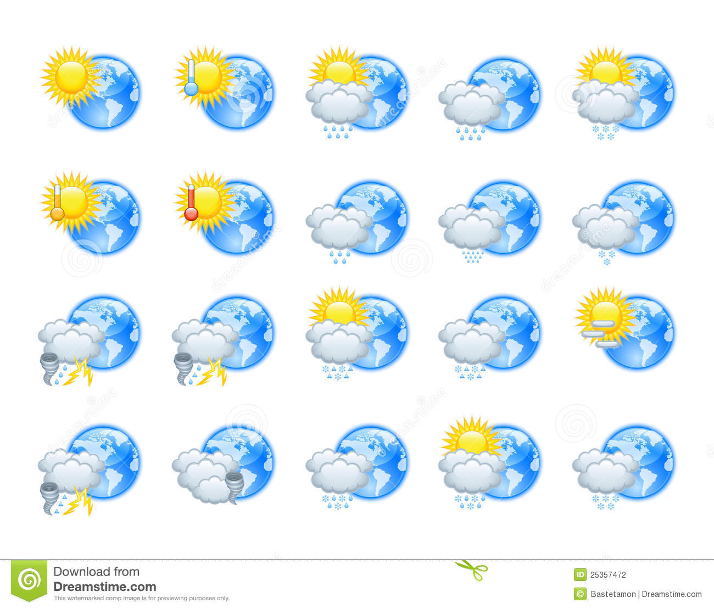


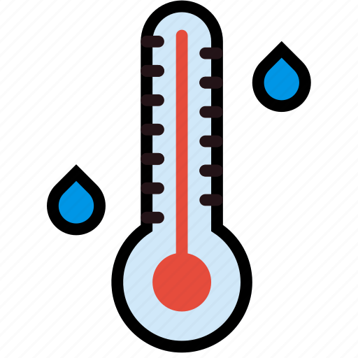




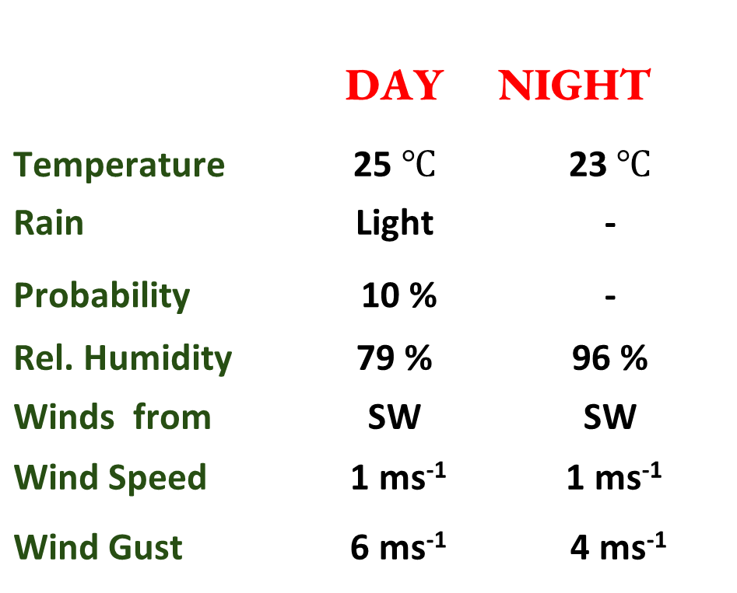
Meteorology and Climate Science
Department of Meteorology, KNUST
24-HOUR FORECAST
01/11/2022 @ 1200 UTC
Rain
Wind
Dust
Forecast Summary (KUMASI)
 | DAY | NIGHT
Temperature | 25 $℃$ | 23$℃$
Rain | Light | -
Probability | 10 % | -
Rel. Humidity | 79 % | 96 %
Winds from | SW | SW
Wind Speed | 1 ms⁻¹ | 1 ms⁻¹
Wind Gust | 6 ms⁻¹ | 4 ms⁻¹
Low risk
Be aware
Be Prepared
Take Action
SUNSET: 05:47 PM SUNRISE: 05:53 AM

